Slide 1
Day 7 – JavaScript Fundamental

Slide 2
Recap
Types of Function
Hoisting and TDZ
Synchronous v/s Asynchronous
String built-in function

Slide 3
Math built-in function
Math.random()
Math.round()
Math.floor()
Math.ceil()
Math.trunc()
Math.pow(x, y)
Math.sqrt()
Math.min()
Math.max()
Math.abs()

Slide 4
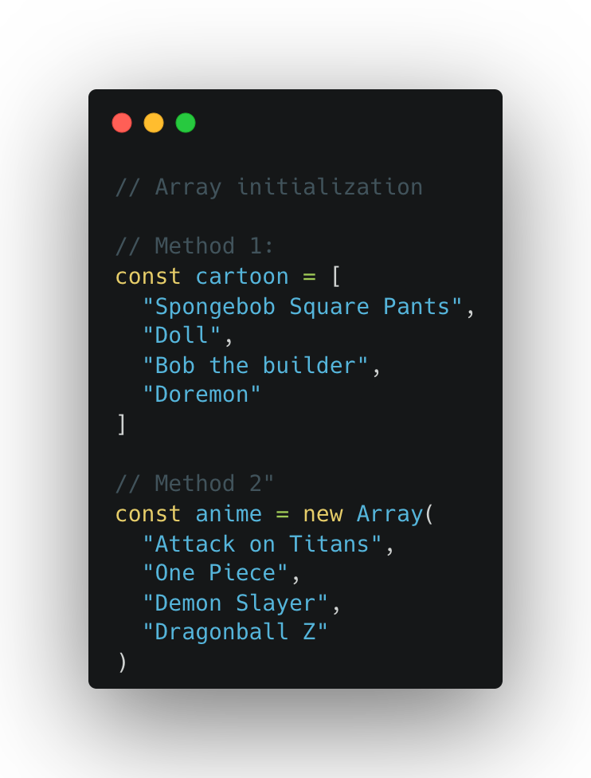
Array
An array is a special box (or container) that can hold many things at once. These things can be numbers, words, or even other boxes (arrays).
Notes:
Why Use Arrays?
Organized Storage: You can keep things in order.
Easy Access: You can quickly grab any item using its position (called the index).

Slide 5
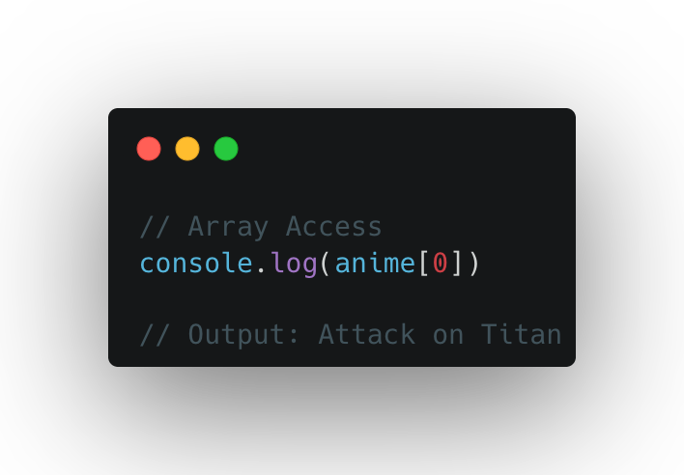
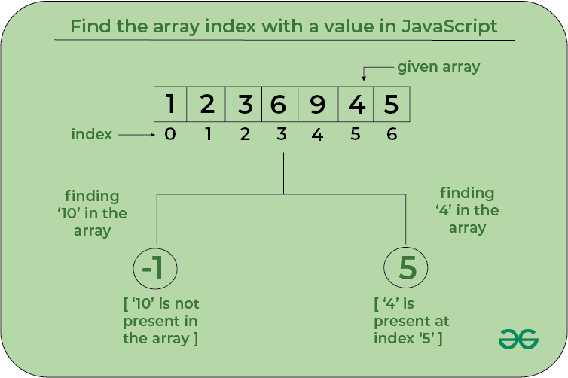
Array Index
Source: https://www.geeksforgeeks.org/how-to-find-the-array-index-with-a-value-in-javascript/

Slide 6
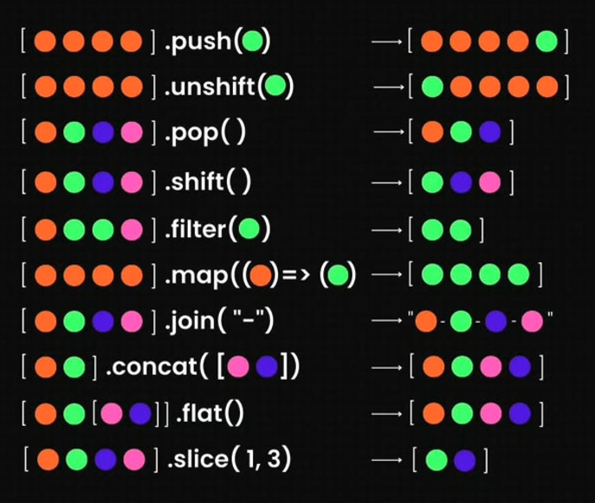

Array built-in function (Visual Representation)

Slide 7
More (Array built-in function )
indexOf()
Reverse()
Sort()
Includes()
findIndex()
Join()

Slide 8
More: map(), filter(), reduce() ………
Map returns a new array containing the results of applying an operation on all original array elements.
Filter returns a new array containing the array elements that passed a specified test condition
Reduce boils (“reduces”) all array elements down to one single value (e.g. adding all elements together)

Slide 9
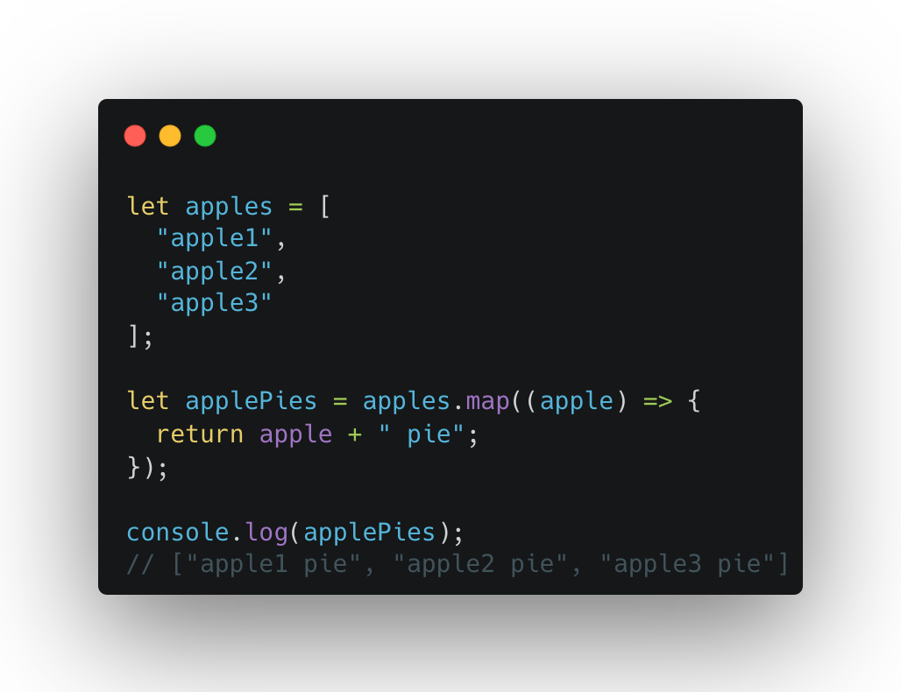
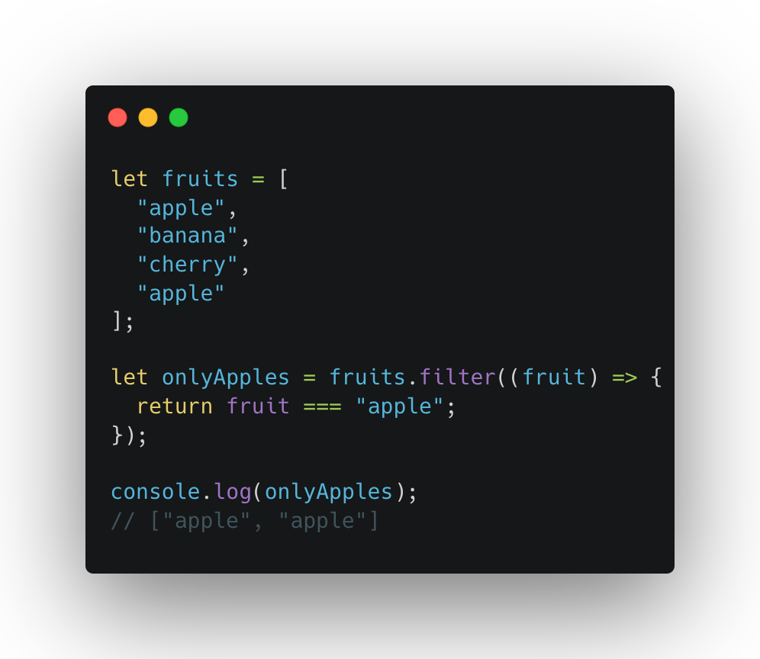
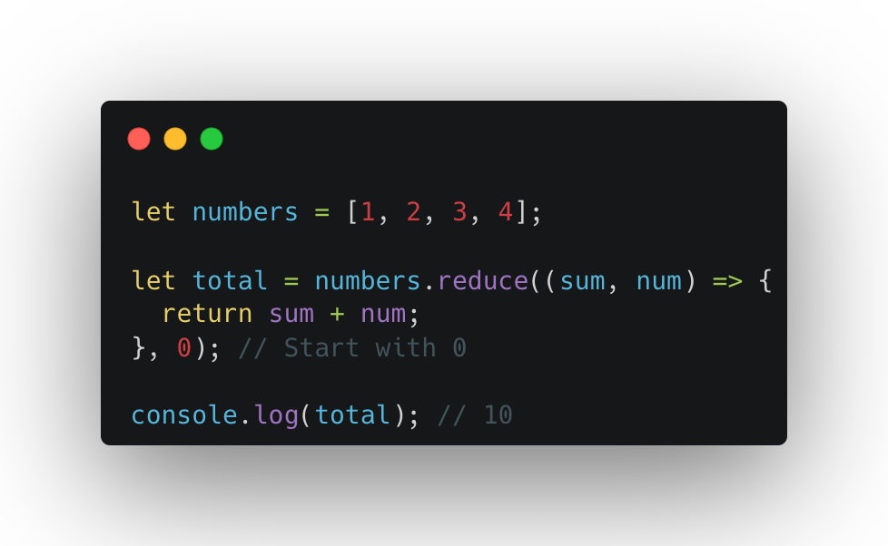
More: map(), filter(), reduce() ………
Notes:
1. The map() Method
Think of it as a Magic Transformation Machine! 🪄
You give it a box of items, and it transforms each item one by one, putting the new items in a new box.
What It Does:
Takes an array, applies a function to each item, and creates a new array with the transformed items.
Example:
Imagine you have a box of apples, and you want to turn them into apple pies.
2. The filter() Method
This is a Magic Sorting Sieve! 🧺
You give it a box of items, and it keeps only the ones you want, throwing away the rest.
What It Does:
Takes an array, applies a test to each item, and creates a new array with only the items that pass the test.
Example:
You have a box of mixed fruits, and you only want the apples.
3. The reduce() Method
This is a Magic Blender! 🥤
You give it a box of items, and it mixes everything together to make one final result.
What It Does:
Takes an array, combines all the items using a function, and reduces it to a single value.
Example:
You have a box of numbers, and you want to add them all together.

Slide 10
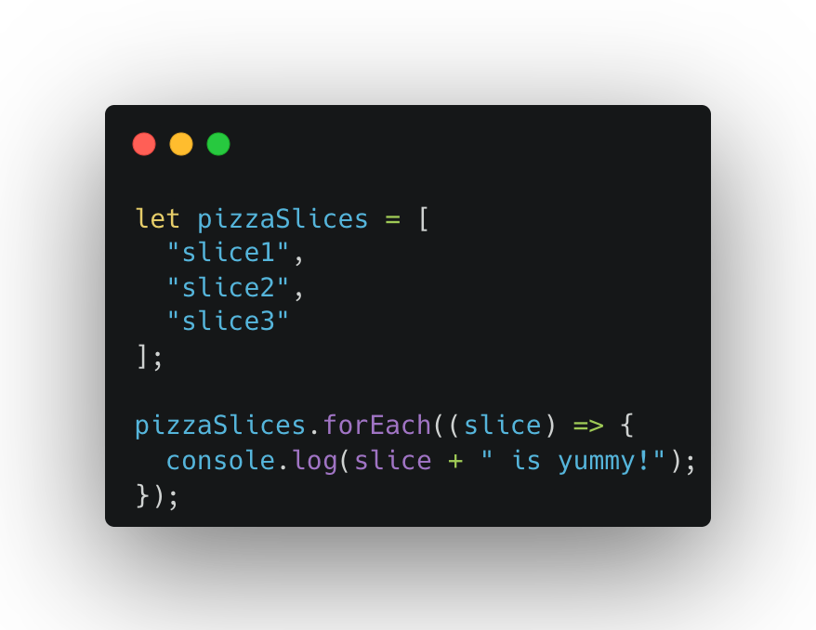
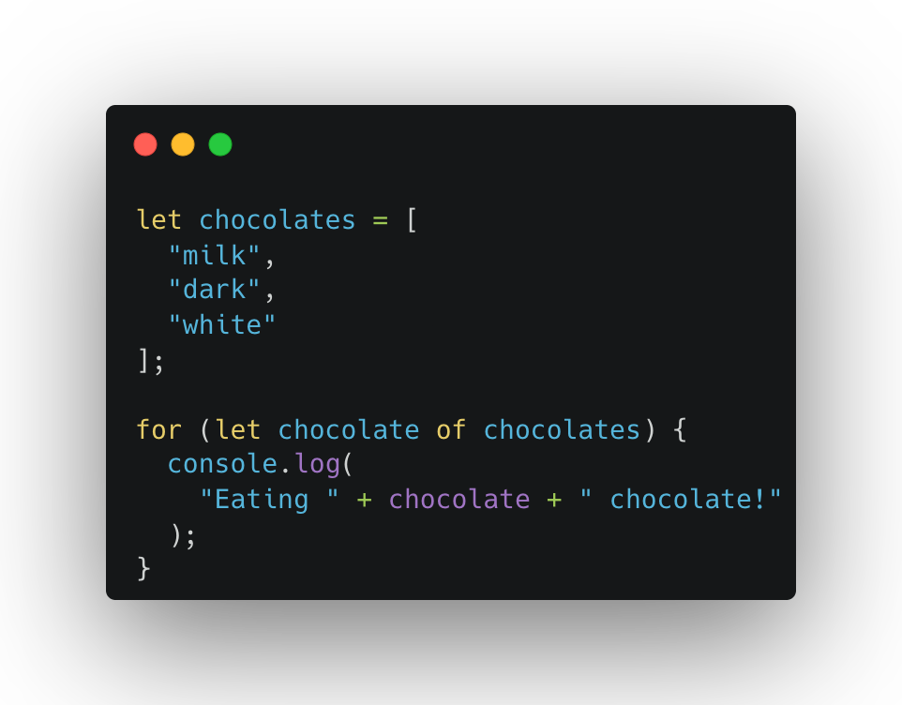
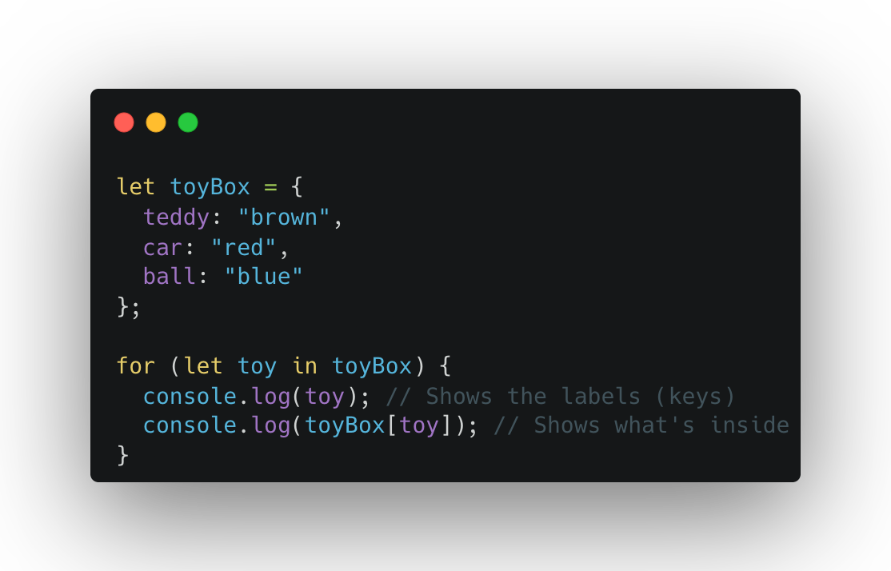
More: forEach(), for(… in …), for(… of …) ……
Notes:
1. forEach()
Imagine a pizza party 🍕
You have a box of pizza slices (array). For every slice, you do something with it, like putting toppings on it.
What It Does:
Loops through an array and does something for each item in it.
Example:
You want to say "Yummy!" for every pizza slice.
2. for...in
Imagine looking through a toy box 🧸
You look at the labels on each toy to see what’s inside. You’re not playing with the toys yet, just checking their names.
What It Does:
Loops through the keys (properties) of an object.
Example:
You have a toy box with labels on each toy.
Imagine passing around a box of chocolates 🍫
Each person takes one chocolate at a time to enjoy.
What It Does:
Loops through the values of an array or iterable (like strings or arrays).
Example:
You have a box of chocolates and eat each one.

Slide 11
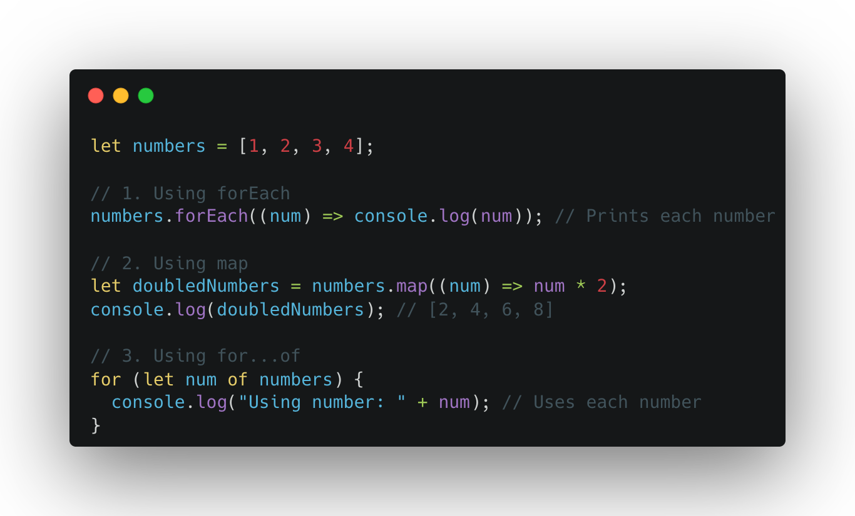
Difference between map, forEach and for…of

Slide 12
Difference between map, forEach and for…of
Feature | forEach() | map() | for...of
Purpose | Perform actions on items. | Transform items to a new array. | Use the values of items.
Returns | undefined (no new array). | A new transformed array. | Nothing (just iterates).
Type of Input | Works on arrays. | Works on arrays. | Works on arrays and iterables.
Use Case | When you want to modify or log items. | When you want a new array of results. | When you want to just loop through values.

Slide 13
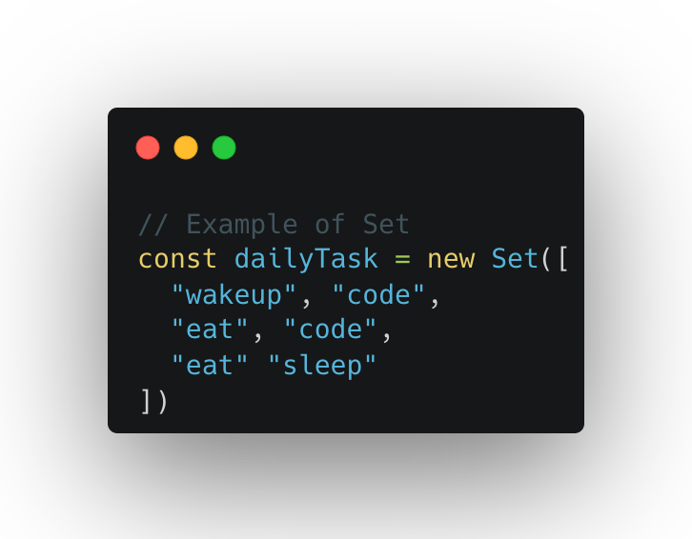
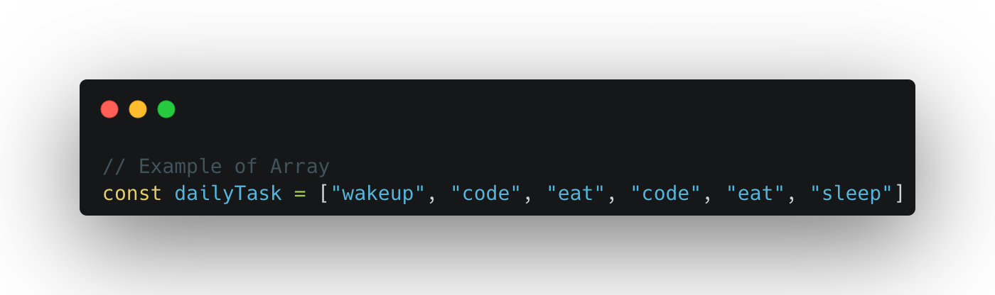
Array V/S Set
Use when you need ordered list of values (might contain duplicates)
Use when you need to manipulate data
Use when you need to work with unique values
Use when high-performance is important
Use to remove duplicates from arrays

Slide 14
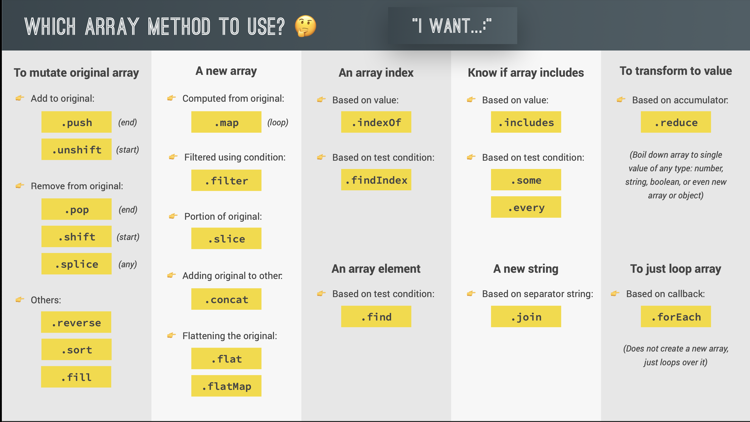


Slide 15
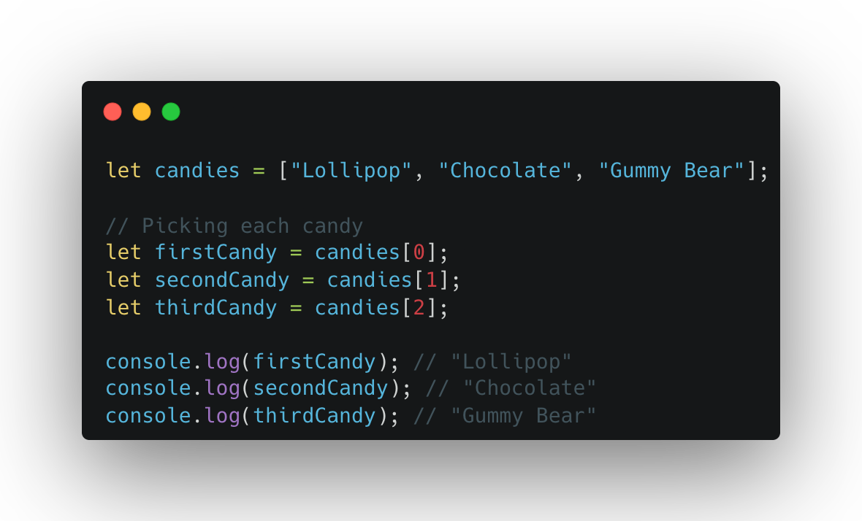
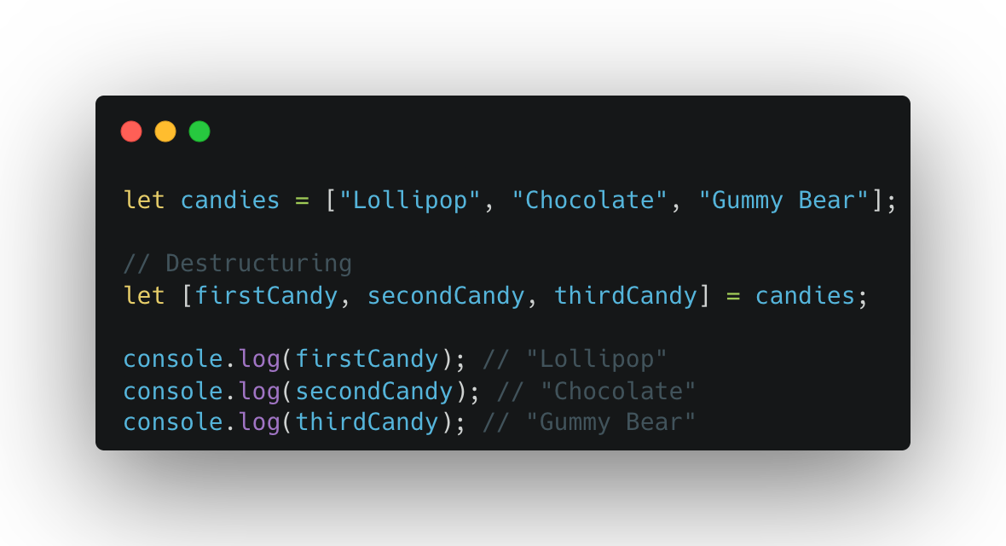
Destructuring
Notes:
Imagine you have a box of candies, and you want to grab them one by one without saying, "Give me the first candy, give me the second candy..." every time. Instead, you can just take them directly and give them cool names like candy1 and candy2.
That’s what destructuring does! It lets you take items from a box (array) and assign them to variables in a super-easy way.

Slide 16
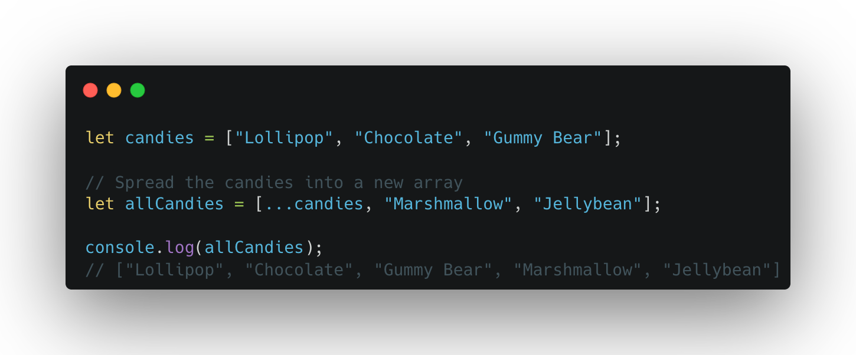
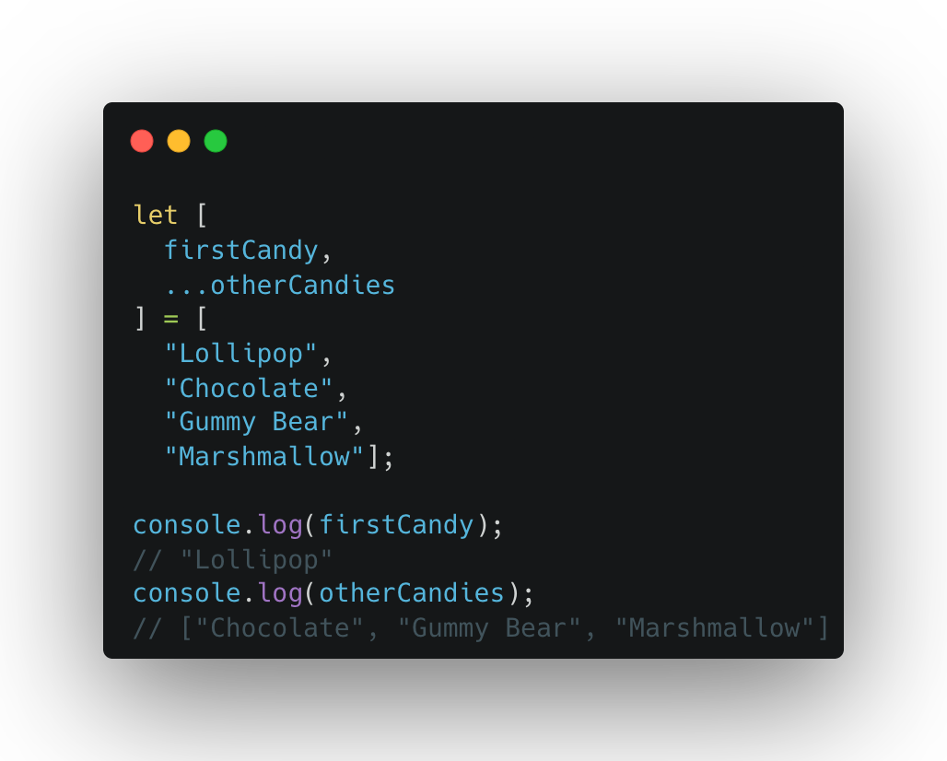
Spread and Rest Operator
Notes:
The Magic of ...
The ... operator is like a magic wand 🪄 that helps you handle many items (like candies 🍬) in a super-easy way. It has two roles: spreading (like unwrapping candies) and gathering (like wrapping candies together).
1. Spread Operator (...)
Think of it as unwrapping a box of candies! 🍭
Imagine you have a candy box, and you want to spread all the candies out on the table. That’s what the spread operator does!
Example: Spreading an Array
How It Works:
The ...candies takes all the candies out of the candies box and spreads them into the new box (allCandies).
2. Rest Operator (...)
Think of it as wrapping candies into a box! 🎁
Imagine you have many candies lying on the table, and you want to gather them into a single box. That’s what the rest operator does!
Example: Gathering Remaining Items
How It Works:
The ...otherCandies gathers all the candies (except the first one) and puts them into the otherCandies box.

Slide 17
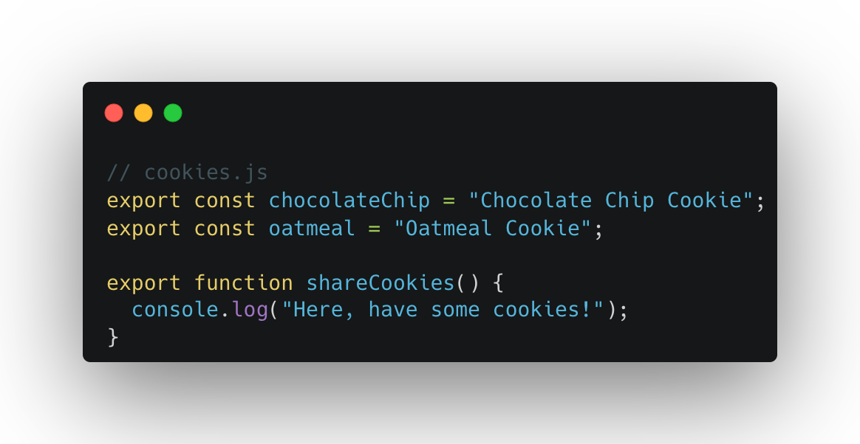
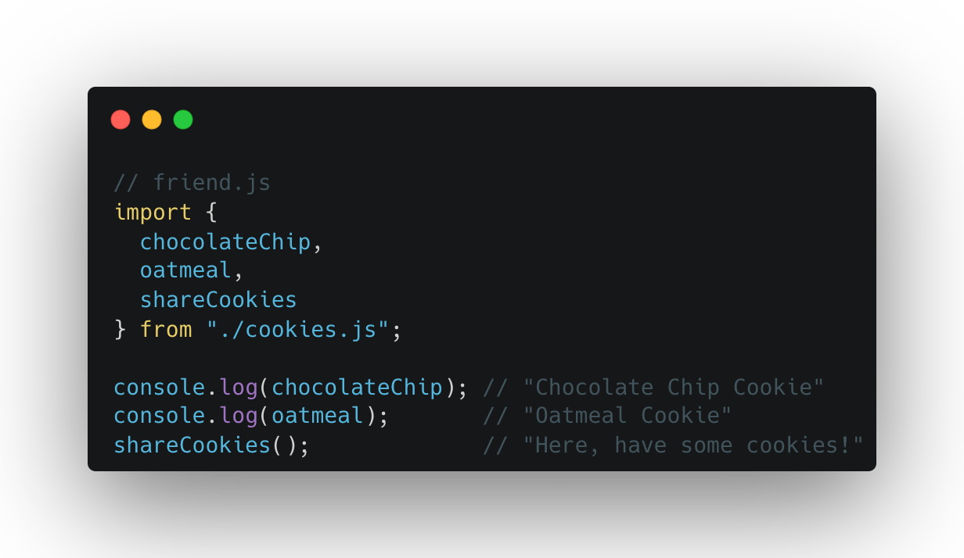
Import and Export
Notes:
What is export?
Imagine you baked some cookies 🍪 and want to share them with your friends. You can “export” the cookies so others can take them and enjoy them.
In JavaScript, export is used to send things (like functions, variables, or objects) from one file to another so they can be used there.
What is import?
Now your friends want to grab the cookies 🍪 you exported. They use import to bring the cookies into their home (file).

Slide 18
Exercise
Password Generator
Hangman
Love Calculator

Slide 19
Feedback
What went well?
What went wrong?
What did you learn?

Slide 20
Credit
https://carbon.now.sh/
https://ascii.co.uk/art
https://appbrewery.com/

Slide 21
I believe that you learn the most if you don’t learn alone but find learning partners and other people with similar interest. - Unknown

